Slide 1

TERM PROJECT:
SCHEDULE DATABASE
MSBA FALL 2019
BAN610
Database Management and Applications
PREPARED BY GROUP 3:
Abhisha Burande (rq5588)
Anshika Sharma (fn5583)
Maitreyee Das (xf7587)
Nidhi Patel (ke9695)
Priyanka Kushwaha (dv7467)

Slide 2
BUSINESS ASSUMPTIONS
Students can be international or domestic applicants.
Each student must have unique student Id i.e NetID
Each Instructor must have unique Instructor Id i.e CsuID
Each student can major in only one field.
Each Instructor belongs to only one department.
Each Instructor will prescribe one or more book for the section he is teaching.
Many instructors can work in a department.

Slide 3
BUSINESS RULES
Each student can take many courses, but needs to take at least one course.
Each course can be taken by many students but need to be taken by at least 1 student.
Each course has one or many sections.
Each instructor can teach one or more sections.
Each course may be taught by one or many instructors but must be taught by at least 1 instructor.
One or more books can be used in each section.
A book can be prescribed by one or more instructor for a course.
Each Course has zero or one Prerequisite.
A book can be prescribed by one or more instructor for a course.

Slide 4
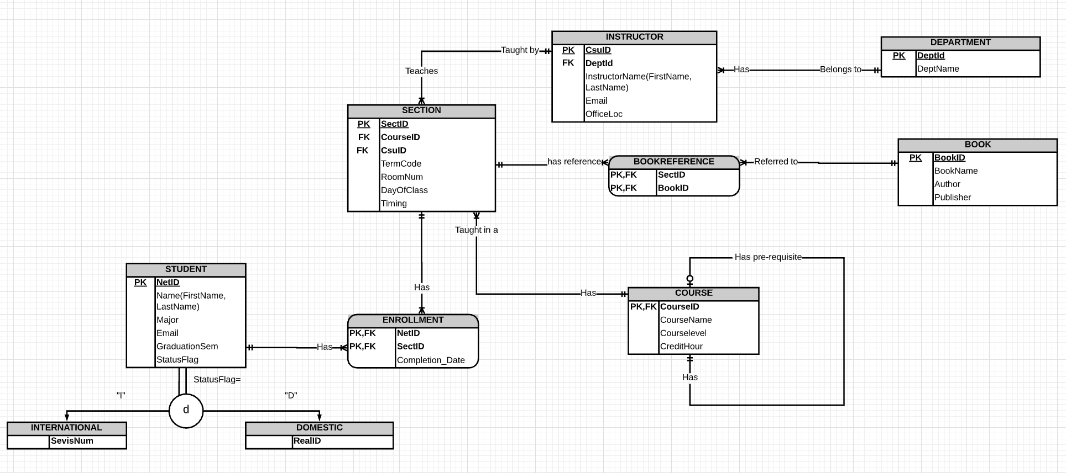
ER DIAGRAM

Slide 5
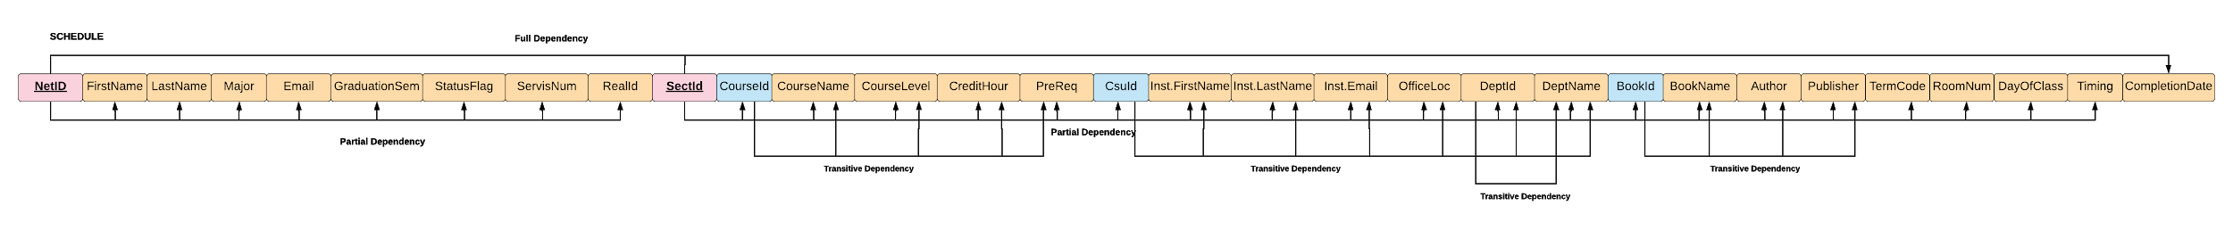
FUNCTIONAL DEPENDENCIES: 1NF RELATIONAL MODEL

Slide 6
1NF FUNCTIONAL DEPENDENCIES
Partial Functional Dependencies
NetID → FirstName, LastName, Major, Email, GraduationSem, StatusFlag, SevisNum, RealID
SectID → CourseID, CourseName, Courselevel, CreditHour, PreReq, CsuID, Inst.FirstName, Inst.LastName,Inst.Email, OfficeLoc, DeptId, DeptName, TermCode, RoomNum, DayOfClass, Timing
Full Dependency
NetID,SectID → CompletionDate
CompletionDate represents full functional dependency, because CompletionDate depends on the composite primary key i.e., NetID,SectID.

Slide 7
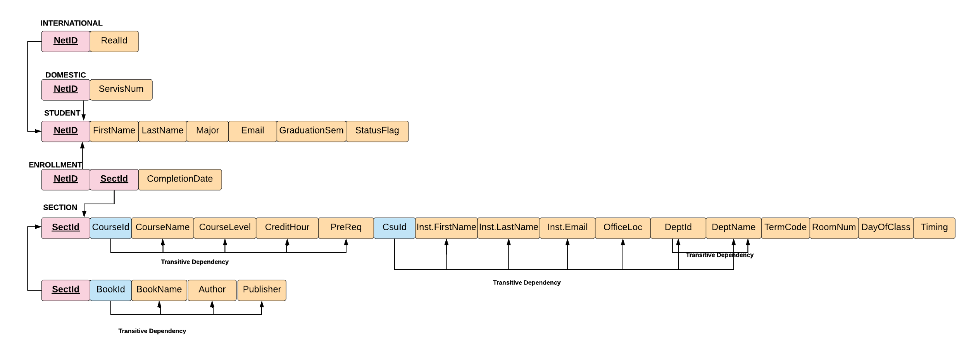
2NF RELATIONAL MODEL

Slide 8
2NF FUNCTIONAL DEPENDENCIES
Transitive Dependencies
SectID → BookID
BookID → BookName, Author, Publisher
SectID → CourseID
CourseID→ CourseName,CourseLevel, CreditHour, PreReq
SectID→ CsuID
CsuID→ Inst.FirstName, Inst.LastName, Inst.Email, OfficeLoc, DeptId, DeptName
CsuID → DeptId
DeptId → DeptName

Slide 9
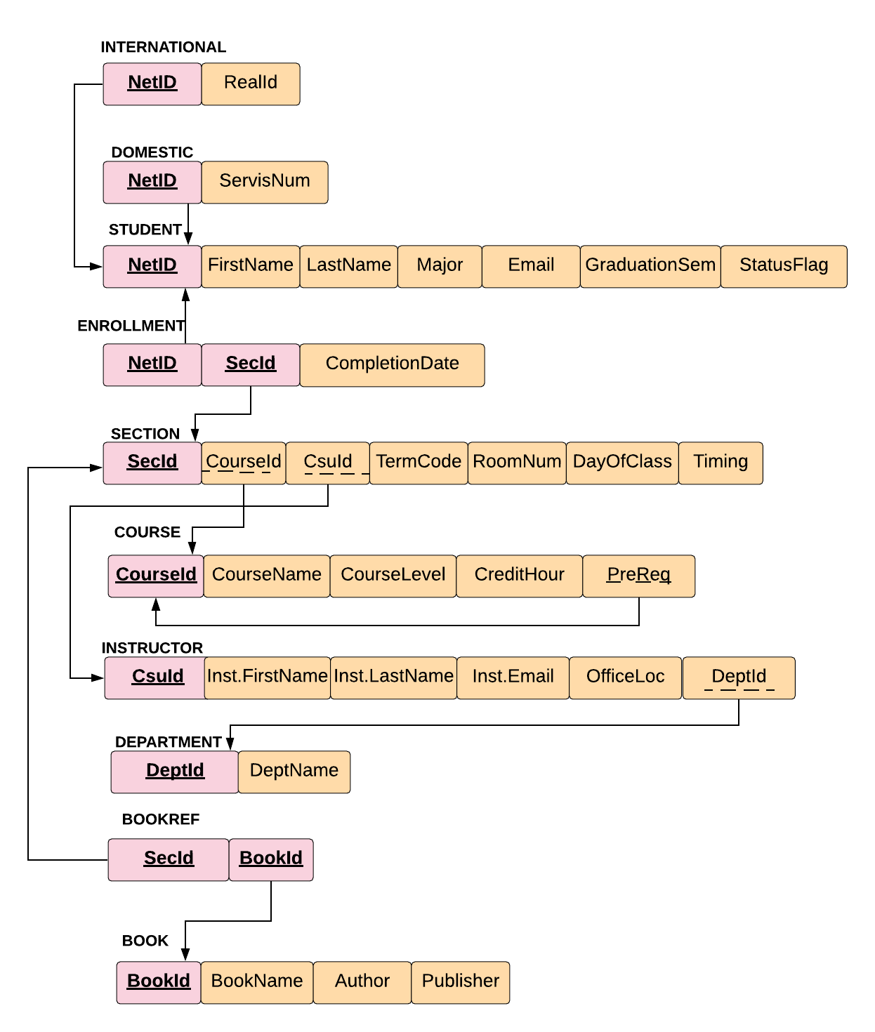
3NF RELATIONAL MODEL

Slide 10
3NF FUNCTIONAL DEPENDENCIES
Functional Dependencies in 3NF normalized database
Student: NetID → FirstName, LastName, Major, Email, GraduationSem, StatusFlag
Section: SectID → CourseID, CsuID, TermCode, RoomNum, DayOfClass, Timing
Course: CourseID → CourseID, CourseName, Courselevel, CreditHour, PreReq
Instructor: CsuID → CsuID, Inst.FirstName, Inst.LastName, Inst.Email, OfficeLoc, DeptId
Department: DeptId → DeptName
Enrollment: NetID, SectID → CompletionSem
Book: BookID → BookName, Author, Publisher
International: NetID → RealID
Domestic: NetID → SevisNum
OUTPUT

Slide 11
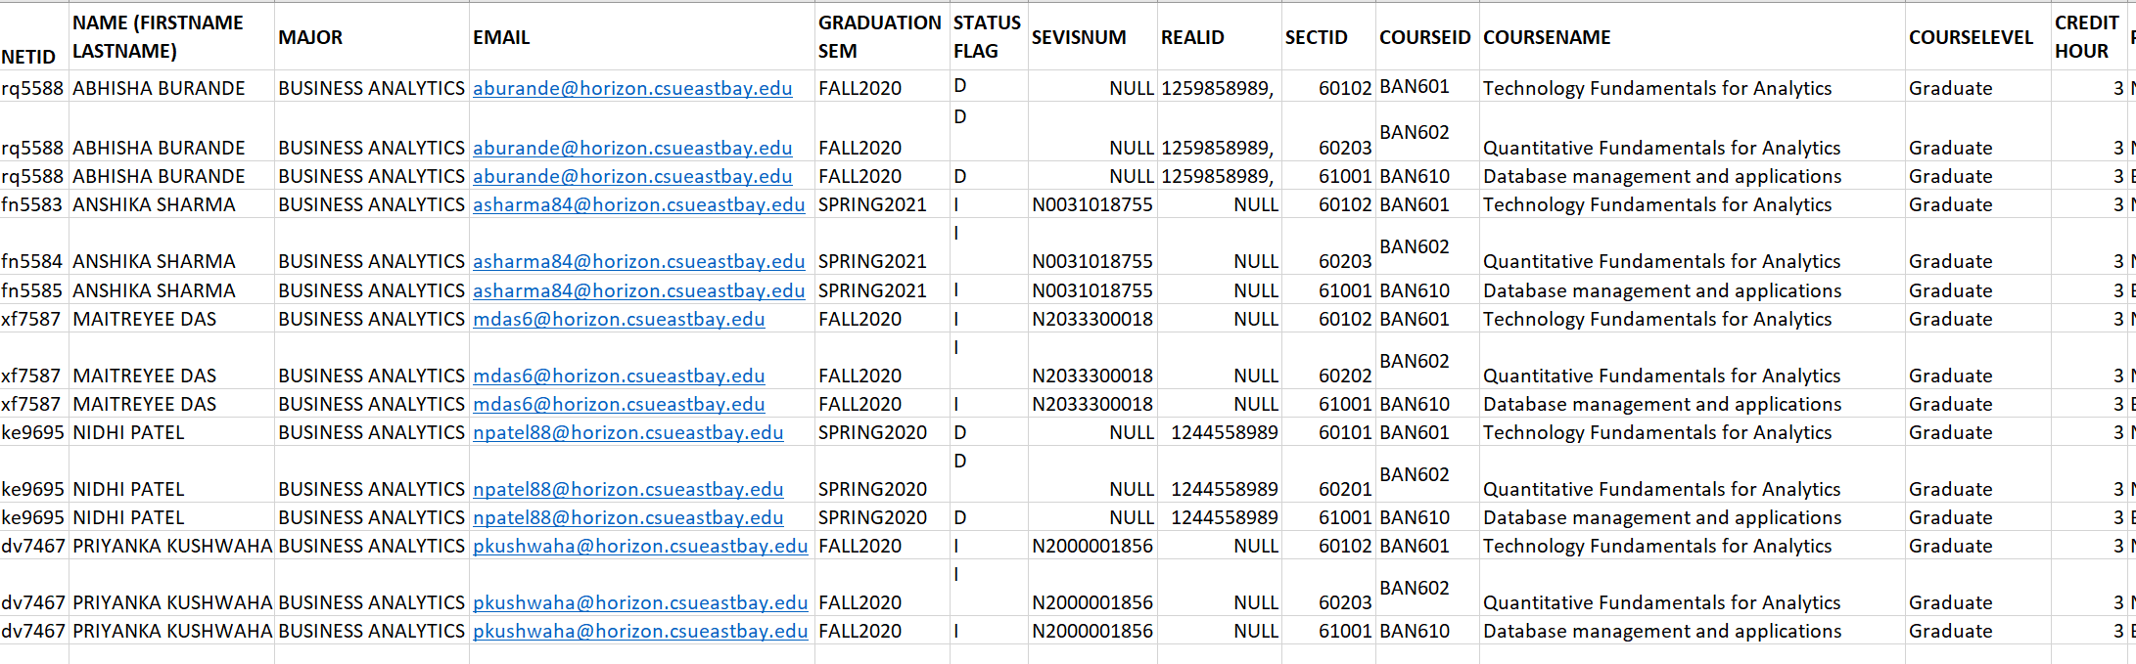
TOTAL DATABASE (Before breaking in individual tables)

Slide 12
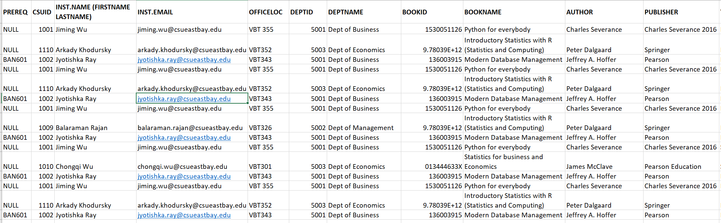
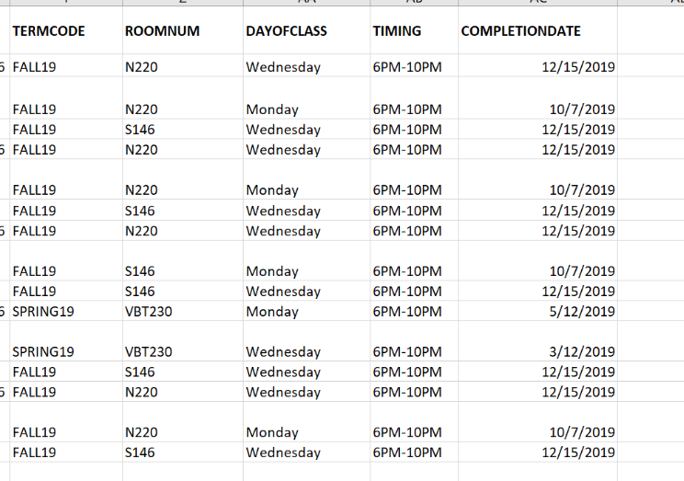
TOTAL DATABASE (Before breaking in individual tables)

Slide 13
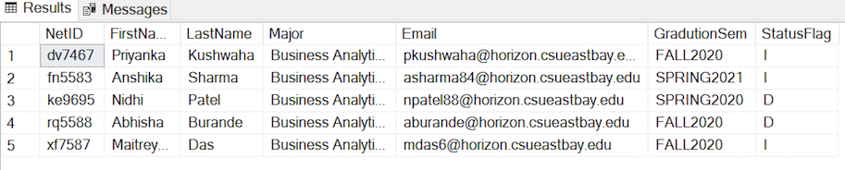
STUDENT TABLE

Slide 14
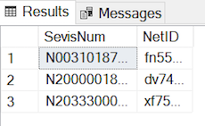
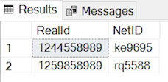
INTERNATIONAL AND DOMESTIC TABLE
International Domestic

Slide 15
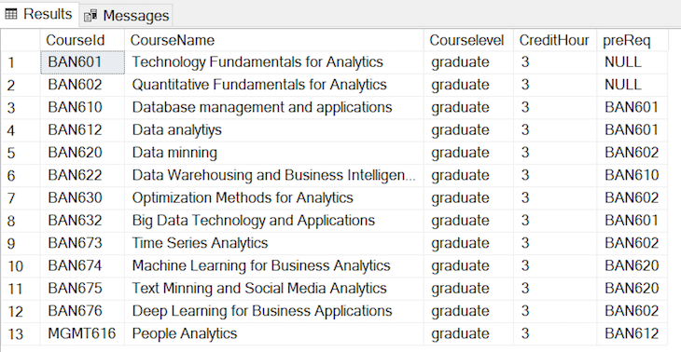
COURSE TABLE

Slide 16
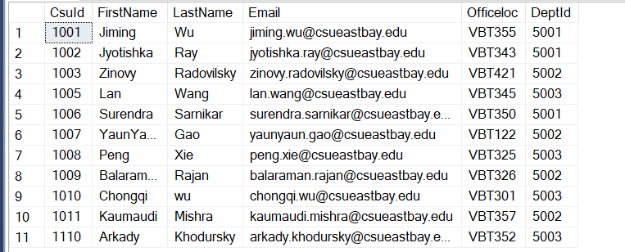
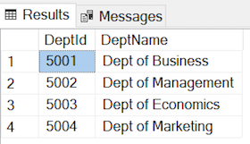
INSTRUCTOR AND DEPARTMENT TABLE
Instructor Department

Slide 17
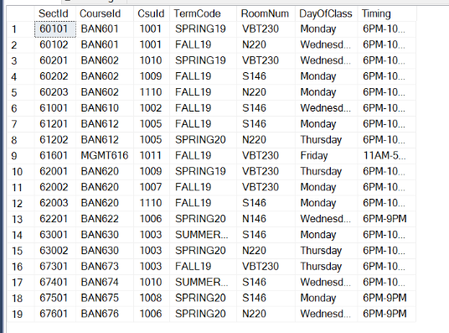
SECTION TABLE

Slide 18
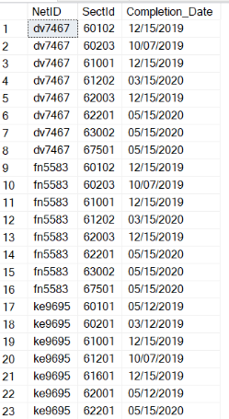
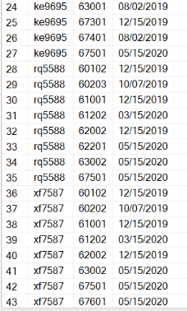
ENROLLMENT TABLE

Slide 19
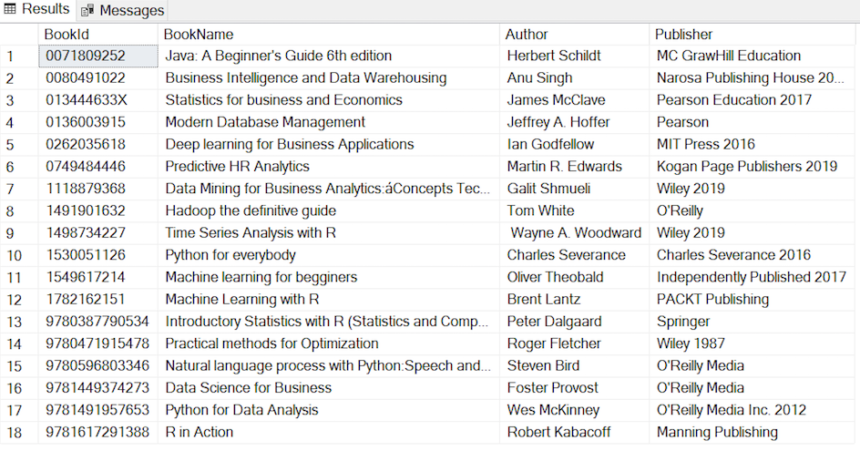
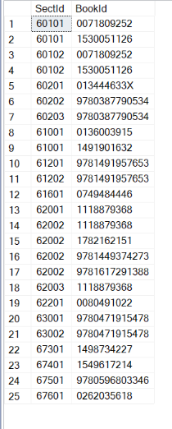
BOOK AND BOOKREF TABLE
Book BookRef

Slide 20
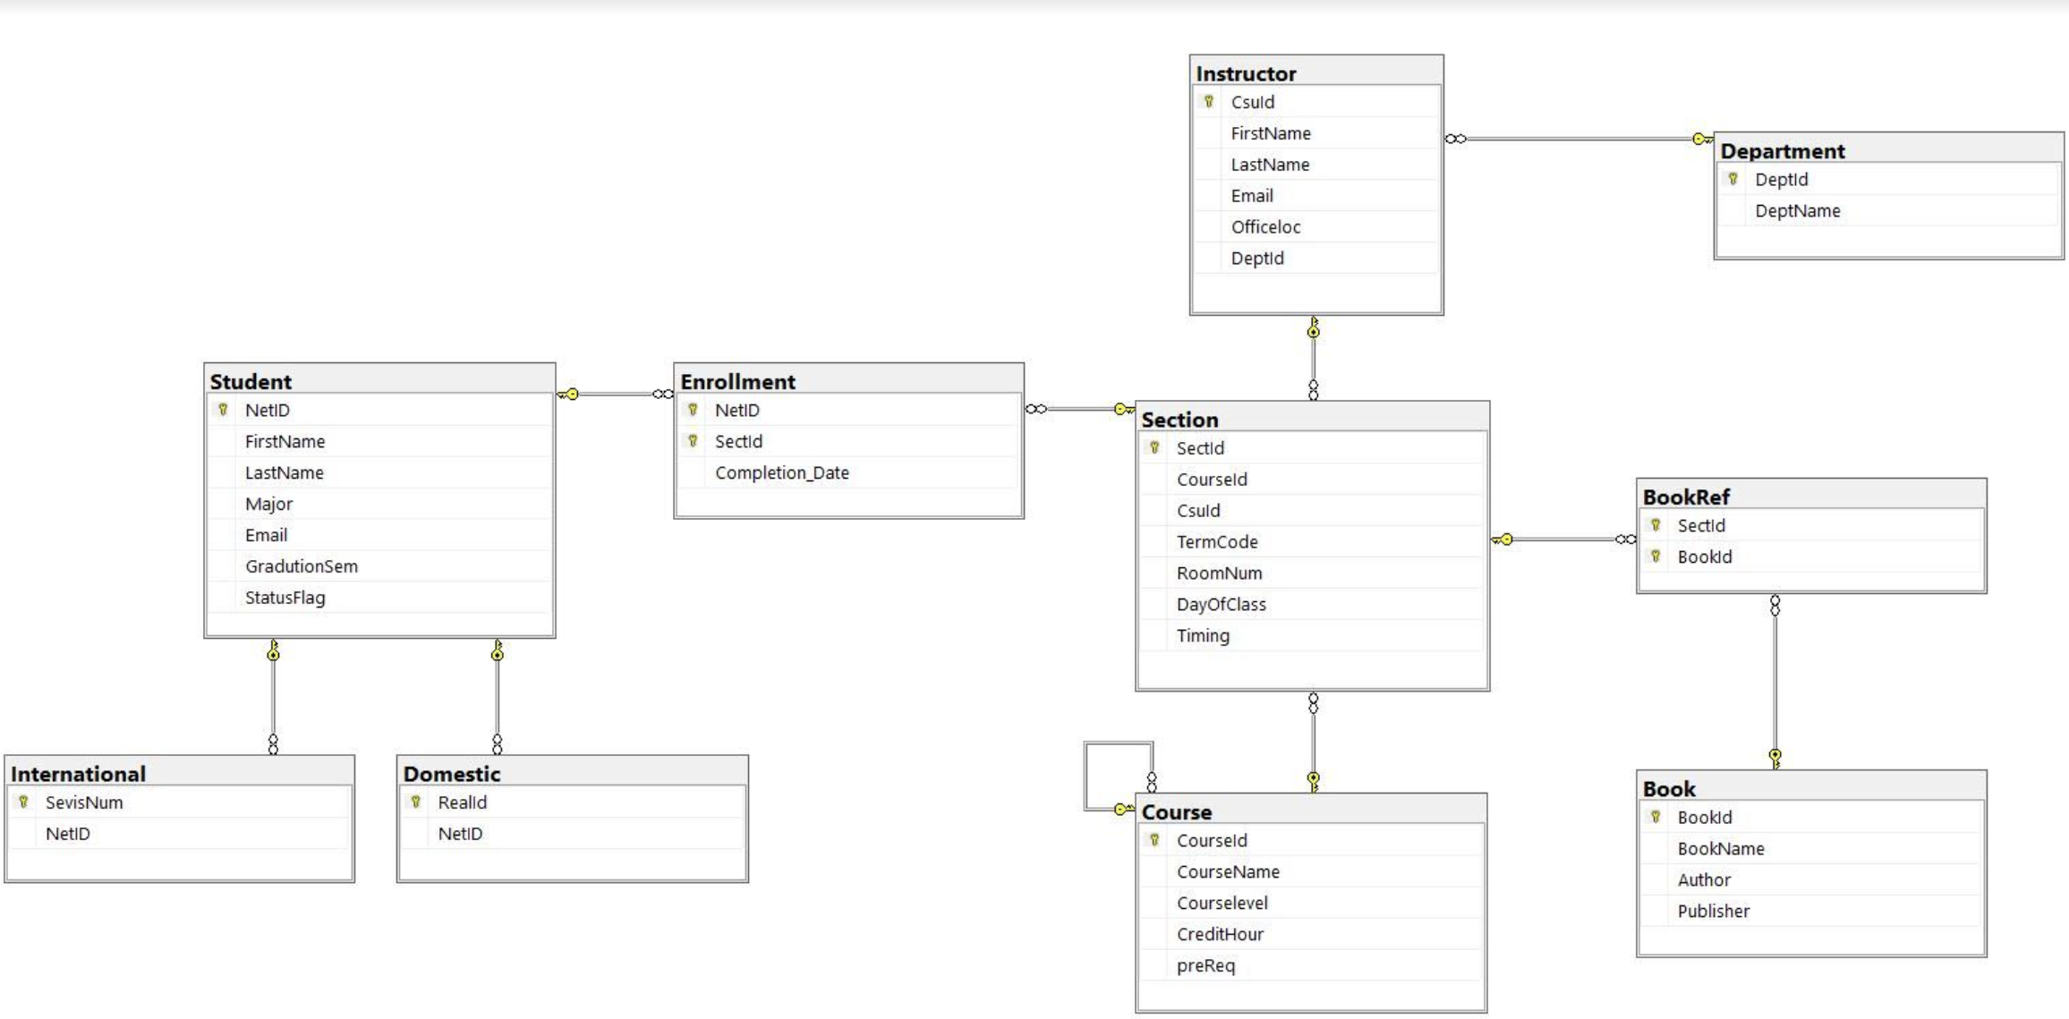
DATABASE DIAGRAM

Slide 21
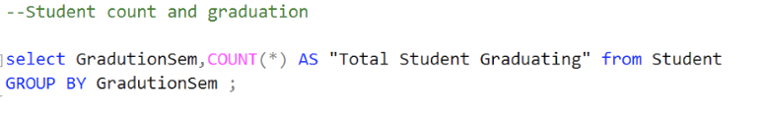
QUERY 1
Display Students Graduating in the same Semester:

Slide 22
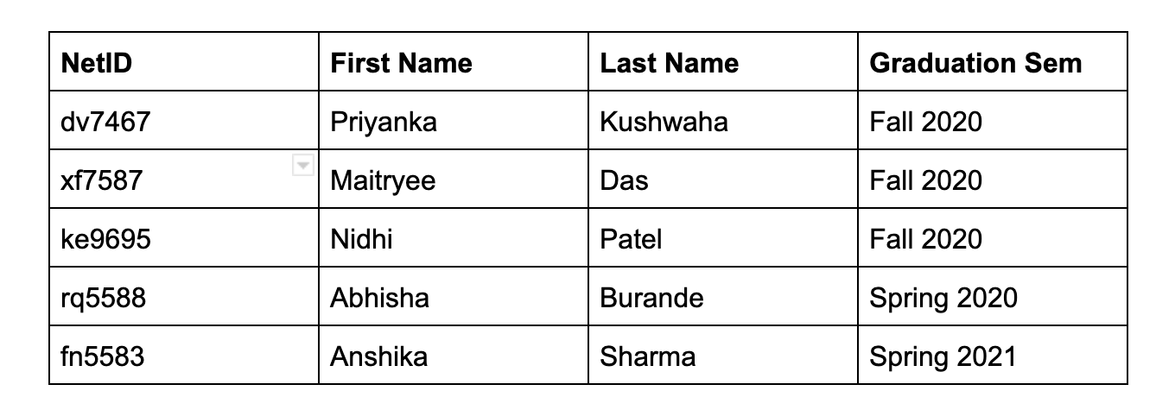
SNAPSHOT OF DATABASE

Slide 23
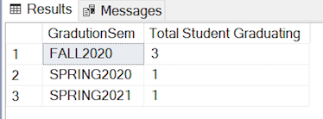
QUERY OUTPUT 1

Slide 24
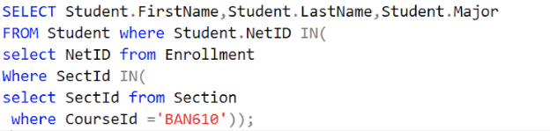
QUERY 2
Display the students name and major who have taken BAN 610:

Slide 25
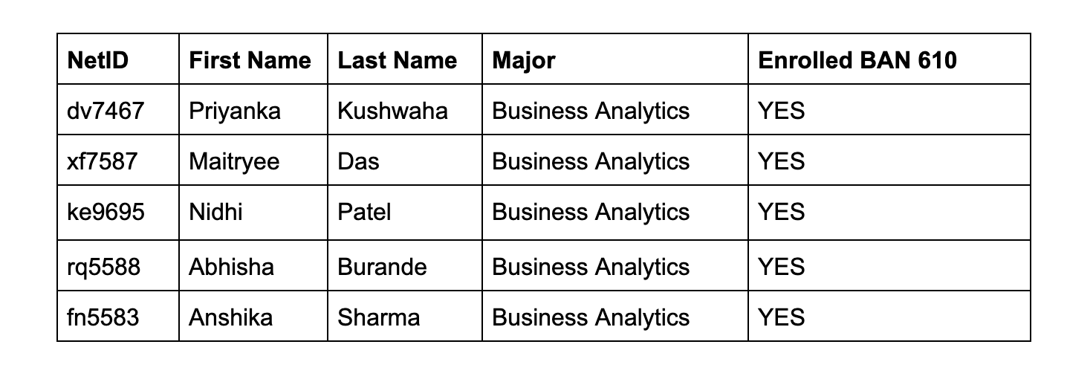
SNAPSHOT OF DATABASE

Slide 26
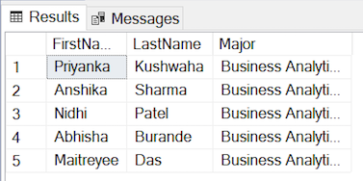
QUERY OUTPUT 2

Slide 27
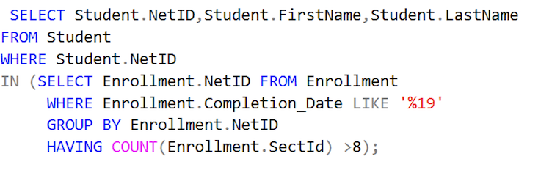
QUERY 3
Display NetID and Student Name who have taken more than 8 courses in 2019:

Slide 28
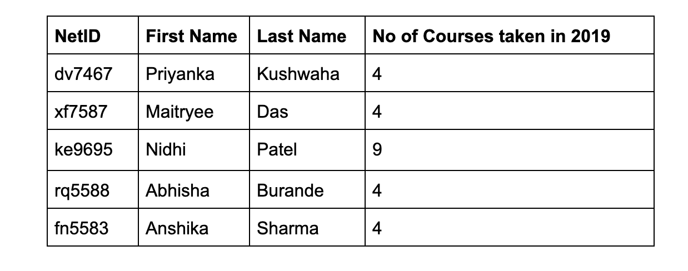
SNAPSHOT OF DATABASE

Slide 29
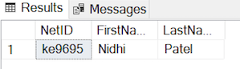
QUERY OUTPUT 3

Slide 30
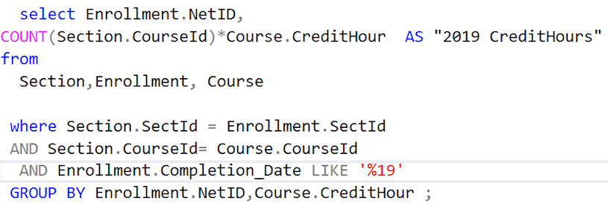
QUERY 4
Display NetID and Total Credit Hours by each student in 2019:

Slide 31
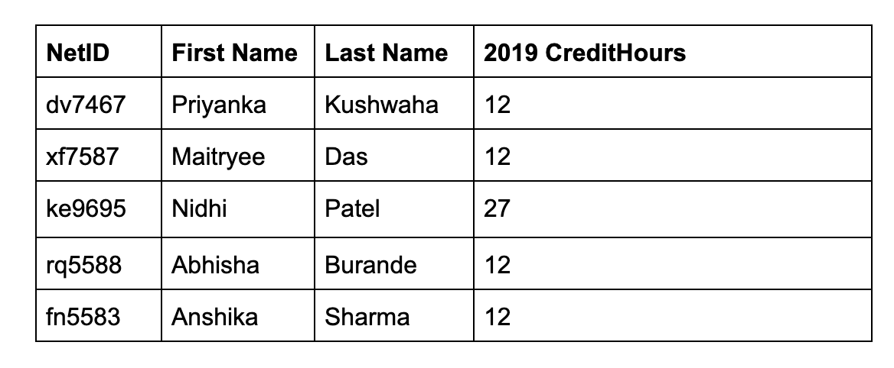
SNAPSHOT OF DATABASE

Slide 32
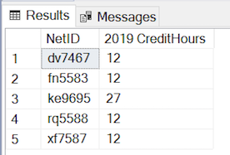
QUERY OUTPUT 4

Slide 33
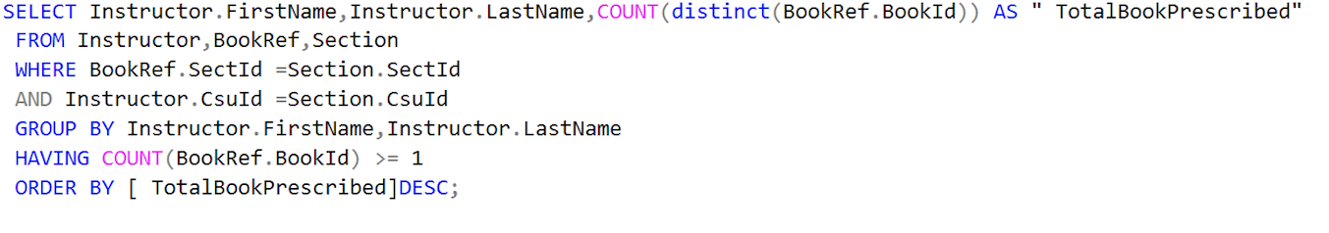
QUERY 5
Display the instructors name and the number of course books prescribed by each instructor:

Slide 34
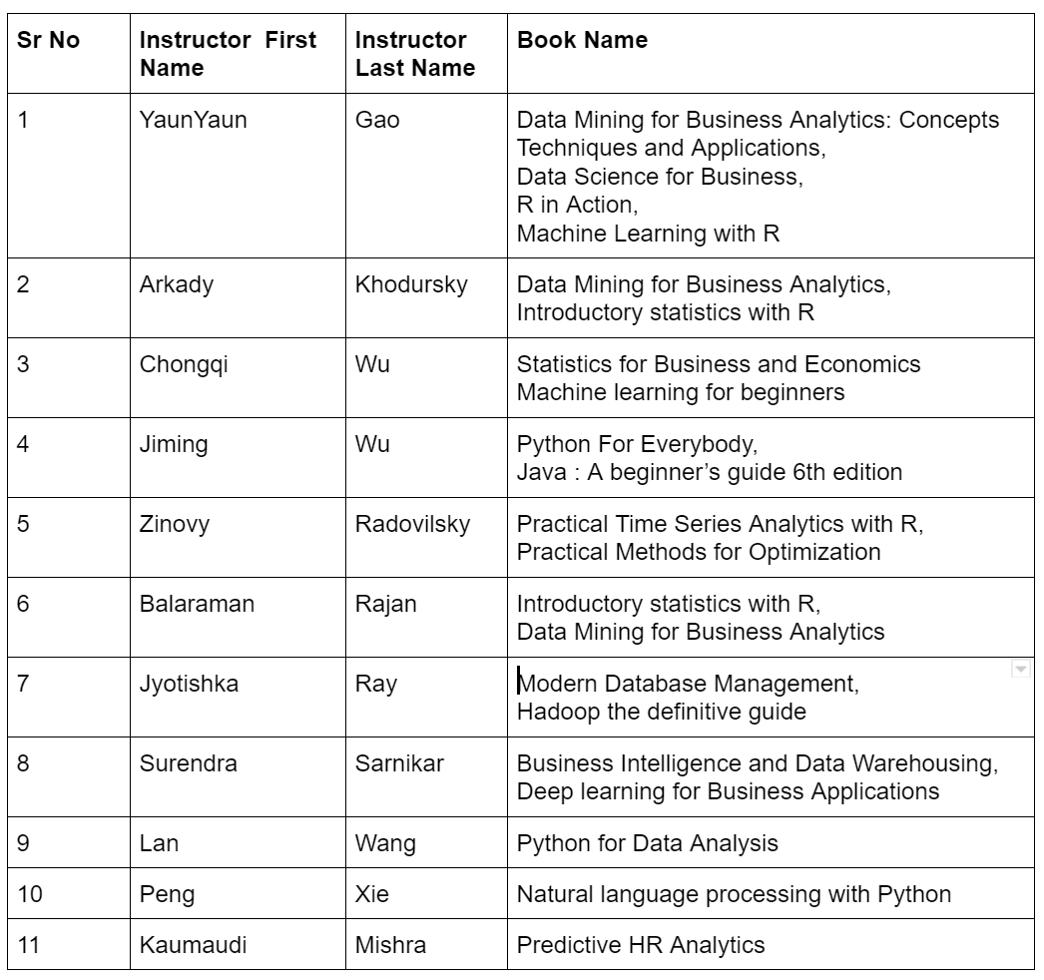
SNAPSHOT OF DATABASE

Slide 35
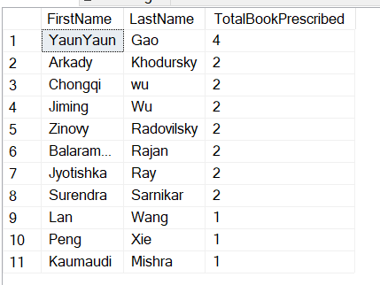
QUERY OUTPUT 5

Slide 36
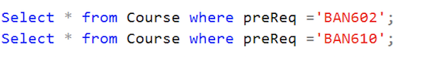
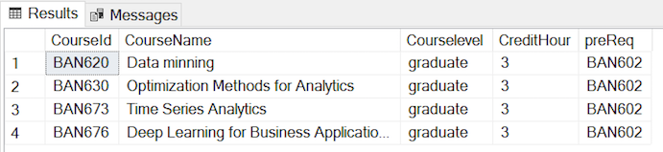
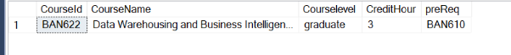
ADDITIONAL QUERY 1
Display course details which has prerequisites BAN602 and BAN610:
OUTPUT
BAN602
BAN610

Slide 37
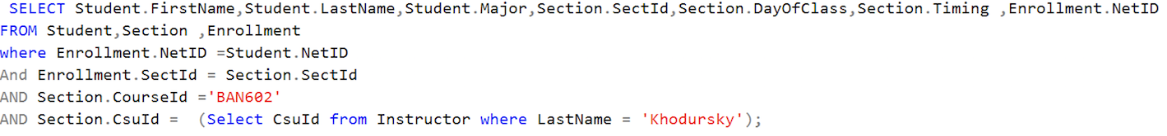
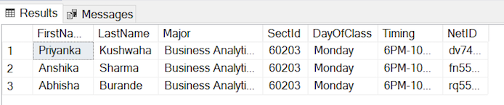
ADDITIONAL QUERY 2
Display student schedule who took BAN602 with Instructor Arkady Khodursky:
OUTPUT

Slide 38
PROJECT CHALLENGES
DEFINING BUSINESS ASSUMPTIONS
AND
BUSINESS RULES
CONTENTION ABOUT PROJECT’S DIRECTION AMONG GROUP MEMBERS
PROJECT CHALLENGES
IMPROVING EFFICIENCY OF QUERIES BY RE-ITERATION
ESTABLISHING ENTITIES
AND THEIR ATTRIBUTES
IDENTIFYING FUNCTIONAL DEPENDENCIES

Slide 39

THANK YOU!
QUESTIONS?

